Slide 1
Computer Organization and Architecture

Slide 2
Module Fundamentals of Digital Computer Unit 6 Execution of Program and Programming Languages

Slide 3
Module: Fundamental of Digital Computer
Unit-6: Execution of Program and Programming Languages
Unit Objectives:
Objective-1: Illustrate the execution of a program in a processor (Analysis)
Objective-2: Describe the format of instructions (Design)
Objective-3: Explain different level of programming languages (Knowledge)

Slide 4
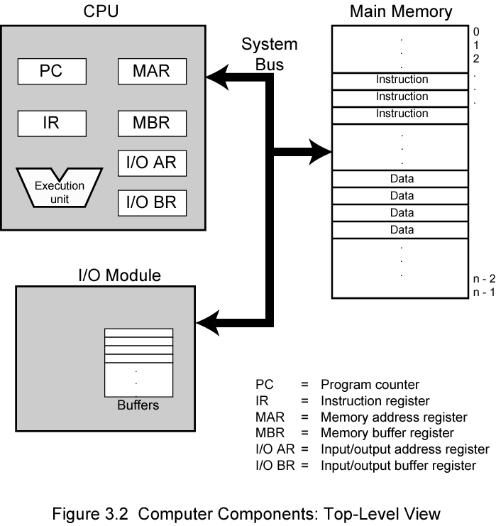
Computer Components: Top Level View

Slide 5
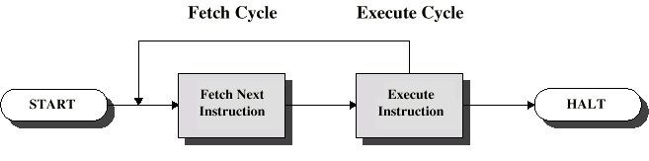
Instruction Cycle
Two steps:
Fetch
Execute

Slide 6
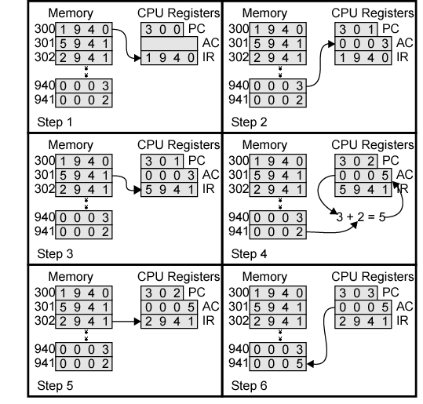
Example of Program Execution

Slide 7
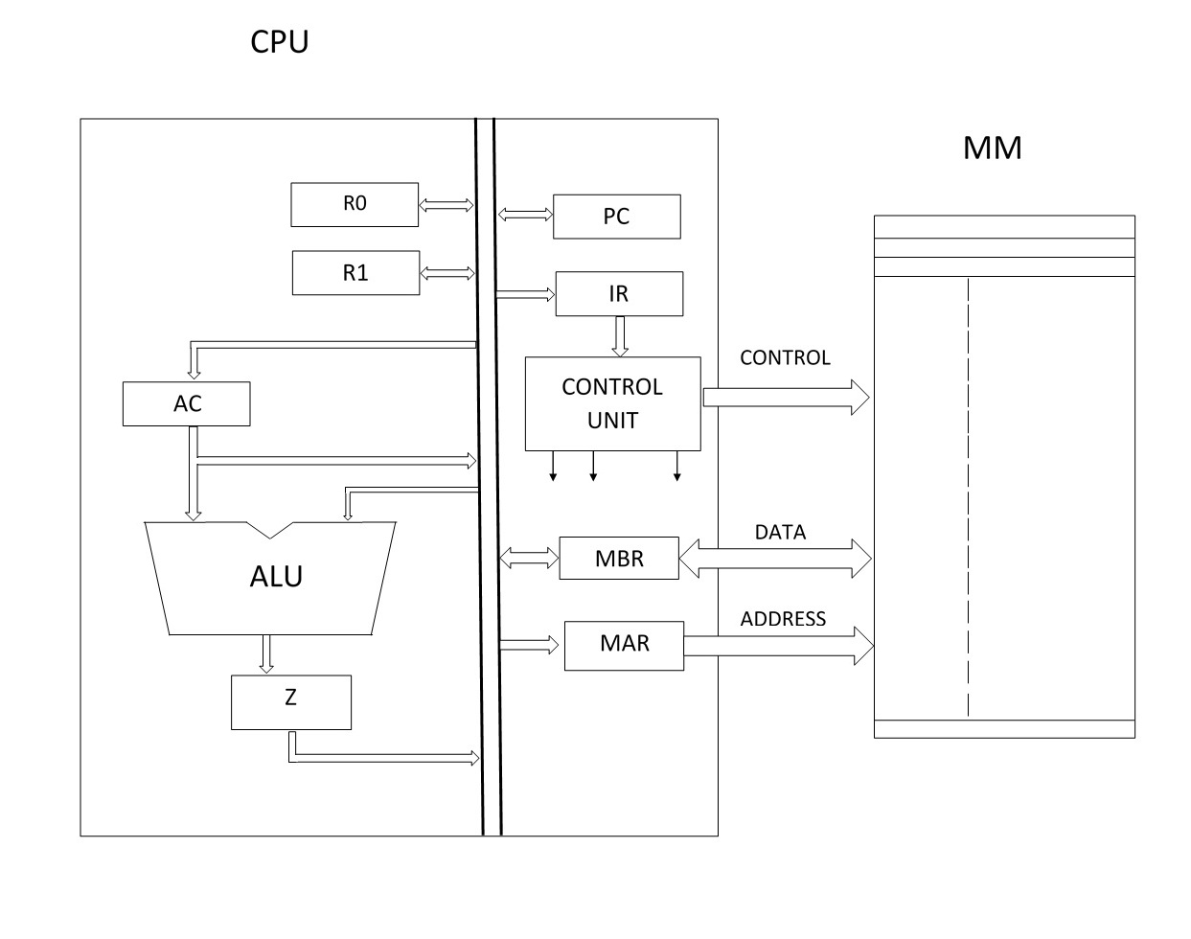
CPU Organization

Slide 8
Format of Instructions

Slide 9
Example of Program Execution

Slide 10
Machine Instruction
Machine | Instruction Format |  |  |  | Assembly
Instruction | Operation | Address |  |  | Code
1940 | 0001 | 1001 | 0100 | 0000 | LDA M
5941 | 0101 | 1001 | 0100 | 0001 | ADD M
2941 | 0010 | 1001 | 0100 | 0001 | STA M
(LDA M) LOAD AC: Load the accumulator by the contents of memory location specified in the instruction
(ADD M) ADD AC: Add the contents of memory location specified in the instruction to accumulator and store the result in accumulator
(STA M) STORE AC: Store the contents of accumulator the memory location specified in the instruction

Slide 11
Computer Program
High Level Code | Assembly Code | Machine Code (HEX)
Y = X + Y | LDA X ADD Y STA Y | 1940 5941 2941

Slide 12
Instruction Format
Number of Instruction: 2⁴ = 16
Number of address space: 2¹² = 4096
OP-CODE | Address
4 bit | 12 bit

Slide 13
Instructions
Op-code | Instruction | Op-code | Instruction
0 |  | 8
1 | LDA M | 9
2 | STA M | A
3 |  | B
4 |  | C
5 | ADD M | D
6 |  | E
7 |  | F

Slide 14
Instructions
Op-code | Instruction | Op-code | Instruction
0 |  | 8
1 | LDA M | 9
2 | STA M | A
3 |  | B
4 | SUB M | C
5 | ADD M | D
6 |  | E
7 |  | F

Slide 15
Instructions
Op-code | Instruction | Op-code | Instruction
0 |  | 8
1 | LDA M | 9 | LDA R
2 | STA M | A | STA R
3 |  | B
4 | SUB M | C | SUB R
5 | ADD M | D | ADD R
6 |  | E
7 |  | F

Slide 16
Instructions
Op-code | Instruction | Op-code | Instruction
0 |  | 8
1 | LDA M | 9 | LDA R
2 | STA M | A | STA R
3 | INC M | B | INC R
4 | SUB M | C | SUB R
5 | ADD M | D | ADD R
6 | DEC M | E | DEC R
7 |  | F

Slide 17
Instructions
Op-code | Instruction | Op-code | Instruction
0 | JMP | 8 | HALT
1 | LDA M | 9 | LDA R
2 | STA M | A | STA R
3 | INC M | B | INC R
4 | SUB M | C | SUB R
5 | ADD M | D | ADD R
6 | DEC M | E | DEC R
7 | JZ | F | JNZ

Slide 18
Program
Write a program to calculate the total marks scored by a student in an examination having six subjects.
Program segment:
t_m = 0, n_s = 6, m[6]
do { t_m = t_m + m[n_s];
n_s = n_s – 1;
} while ( n_s > 0)

Slide 19
Assembly Level Program
 | Assembly code | Remarks
 | LDA M1 | // No. of subjects
 | STA R1 | // Keep it in registrar R1
 | LDA M | // mark of first subject
 | DEC R1
Loop | ADD M | // marks of subsequent subject
 | DEC R1
 | JNZ Loop
 | STA M2 | // store the total score
 | HALT | // stop execution

Slide 20
Assembly Level Program
 | Assembly level
 | LDA M1
 | ADD M2
 | ADD M3
 | ADD M4
 | ADD M5
 | ADD M6
 | STA M7
 | HALT

Slide 21
Computer Program
 | Assembly Level | Machine Level
 | LDA M1 | 1 701
 | ADD M2 | 5 702
 | ADD M3 | 5 703
 | ADD M4 | 5 704
 | ADD M5 | 5 705
 | ADD M6 | 5 706
 | STA M7 | 2 700
 | HALT | 8 000

Slide 22
Computer Program
 | Assembly Level | Machine Level | Memory Location
 | LDA M1 | 1 701 | 150
 | ADD M2 | 5 702 | 151
 | ADD M3 | 5 703 | 152
 | ADD M4 | 5 704 | 153
 | ADD M5 | 5 705 | 154
 | ADD M6 | 5 706 | 155
 | STA M7 | 2 700 | 156
 | HALT | 8 000 | 157

Slide 23
Test Items
Q1. Why there are three levels of programming languages (Objective 3)
Q2. What is assembler and compiler. What is an interpreter. (Objective 3)
Q3. Why it is not possible to implement the loop with the given instruction set of the processor discussed in this lecture. (Objective 1 & 2)

Slide 24
Module: Fundamentals of Digital Computers

Slide 25
Module: Fundamental of Digital Computer
Module Units
Unit-1: Model of Computer and working principle
Unit-2: Digital logic building blocks
Unit-3: Information Representation and Number system
Unit-4: Basic elements of the processor
Unit-5: Storage and I/O interface
Unit-6: Execution of program and programming languages

Slide 26
Computer Components: Top Level View

Slide 27
Module: Fundamental of Digital Computer
Module Objectives
Objective 1: Describe the Model of Computer and working principle of Computer (Analysis)
Objective 2: Preliminaries of Digital Building Blocks (Knowledge)
Objective 3: Describe the representation of Information and Number Systems (Knowledge)
Objective 4: Explain the components of Processor (Comprehension)
Objective 5: Describe the Interfacing mechanism of storage unit and I/O devices (Comprehension)
Objective 6: Explain the execution of Program in a processor and categories of computer programming languages (Application)

Slide 28
Module Level Problems
Q1. Consider a processor having an ALU with 4 Arithmetic and 4 Logic operations. The size of the data bus is 8 bits. Indicate how to use a particular operation of the ALU. Construct some examples to carryout some of these ALU operations and check the CARRY, SIGN and OVERFLOW. Provide the circuit to set the CARRY (C), SIGN (S), OVERFLOW (OV) and ZERO (Z) flags. (Objective 2, 3 and 4)

Slide 29
Module Level Problems
Q2. What are the different categories of instructions in a processor. Design an instruction set in such a way that some of the instructions are having memory indirect cycle. Indicate the format of the instructions and the tasks performed by the instructions. Now try to write a program having loop with the help of this instruction set. (Objective 1, 4, 5 & 6)

Slide 30
Fundamental of Digital Computer

